Slide 1

WhatsApp CHAT ANALYSIS USING PYTHON

Slide 2












Chate Group Members
Mayuresh
Mohit
Priyesh
Shantanu
Jay Bhanushali
Divyan Suratwala
Aditya Yadav
Bhavesh Solanki
Jesus
Vishal
Suyash
Parth
Abhishek

Slide 3






Lets see what we can get
Group Created on 30th Jan 2017
Total Active Days : 345
Total Members : 12
Total Media Shared : 1393
Total Words Used : 2,11,999
Total letters Used : 10,97,145

Slide 4


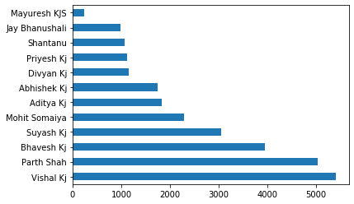


OK! Lets see who is the most talktive
Most `Talkative
Vishal
least `Talkative
Mayuresh

Slide 5


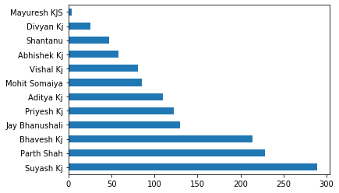


There is one guy who always spams with images/memes!
SPAMMERRRRRRR SUYASH
120 Videos
169 Images/memes
I wonder what are this videos, all boys group cannot predict

Slide 6
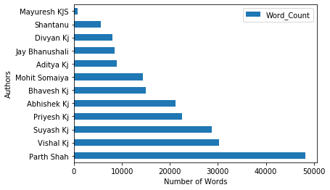

The sesquipedalian of the group!
Sesquipedalian : The one who uses to many complex words
Ohkay That’s me! Uhhh
Total words used: 48,207
That’s a 23% of total words used in this group since 2017, what!!!!
Actually they don’t really understand my sense of humour so I have to use lots of words! Crapppp!

Slide 7
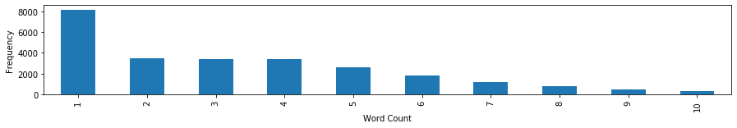
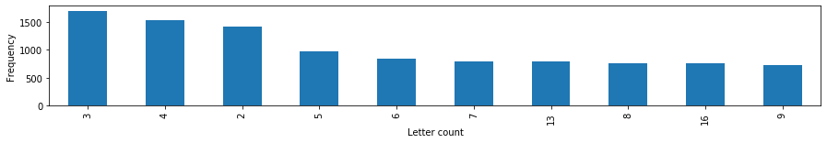
Hmm!! Lets play with words and letters
Word Count per mesaage
Ohkay! So most of the messages only contain 1 word! Interesting, I wonder this 1 word messages are not in English
Letter Count per mesaage
3 letter word is the most famous one here! I can’t think of any 3 letter word in English but there are many in hindi :P

Slide 8

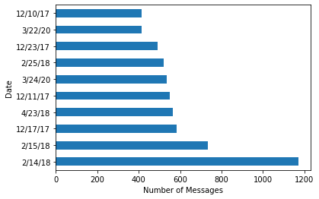


The most active date
A boys group is always active!
14th February 2018
WELL No reasons needed! Why a all boys group is so active on a VALENTINE DAY. Curtains Down!
“Sab single mareagay”
10-11 Pm is the most active Hour!
3pm-4pm is the least active Hour! afternoon sleep

Slide 9

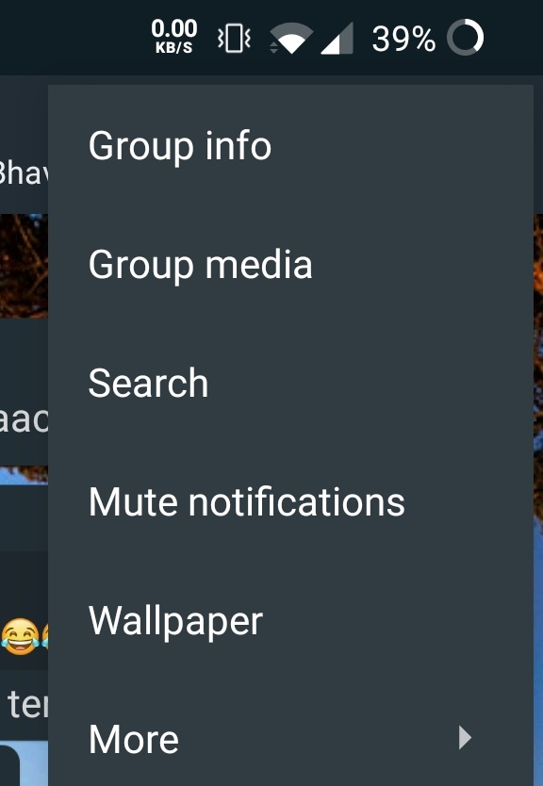
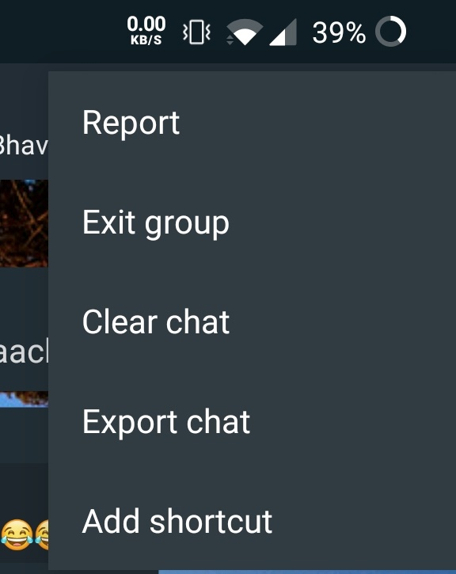
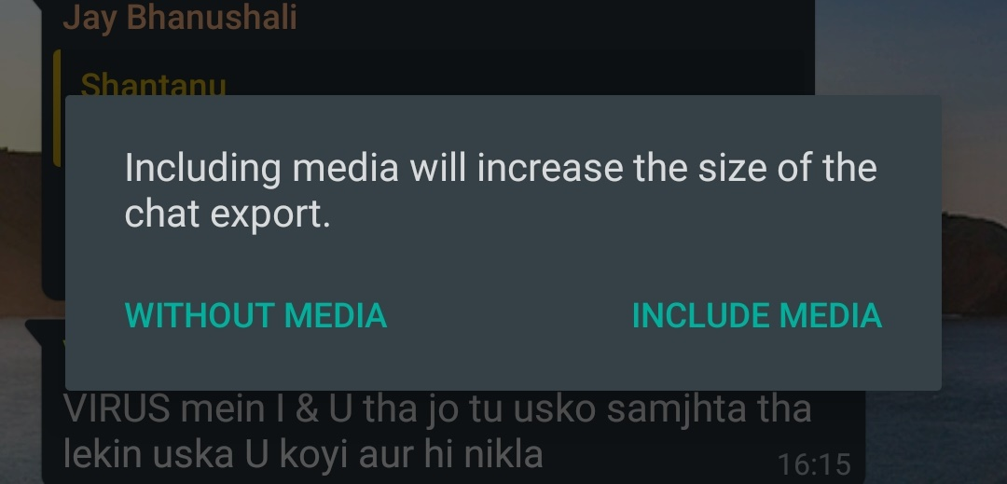
Summary
WhatsApp has this amazing feature of Export Data from any of your chats
Click on the 3 dots option on upper right hand side of the corner
Click on the “More” option
Click on the export Data
Click on the WITHOUT MEDIA option and tadaaaa file is ready

Slide 10
CONCLUSIONS
There are so many matrix which can still be calculated from the chats
Exploring emoticons, tags, GIF is remaining
Free text analysis, sentiment analysis, word analysis can be done(Word clouds)
LEARNINGS :
Regular expressions
Analytic parameters
Text Analytics
Power point
REFEERANCE :
https://towardsdatascience.com/build-your-own-whatsapp-chat-analyzer-9590acca9014
https://regexr.com/

